Slide 1
Chapter 6
Verbal Communication Skills
This multimedia product and its contents are protected under copyright law. The following are prohibited by law:
any public performance or display, including transmission of any image over a network;
preparation of any derivative work, including the extraction, in whole or in part, of any images;
any rental, lease, or lending of the program.

Slide 2
Learning Objectives After reading this chapter, you should be able to:
6.1 Describe how words create meaning.
6.2 Identify how words influence our perceptions, thoughts, actions, culture, and relationships.
6.3 Identify and describe word barriers that lead to misunderstandings.
6.4 Use words to provide support and comfort, and to avoid defensiveness.
6.5 Use words to have conversation with others.
6.6 Use words to offer an apology when appropriate.
6.7 Use assertiveness skills appropriately and ethically.

Slide 3
How Words Work (1 of 5) 6.1 Describe how words create meaning.
Words are Symbols
Symbols represent something else, like a thought, concept or object.
Referents are the things symbols represent.
Thoughts are mental processes triggered by a referent or symbol.
Notes:
Symbol: word, sound, or visual image that represents something else, such as a thought, concept, or object
Referent: the thing that a symbol represents
Thought: mental process of creating an image, sound, concept, or experience triggered by a referent or symbol

Slide 4
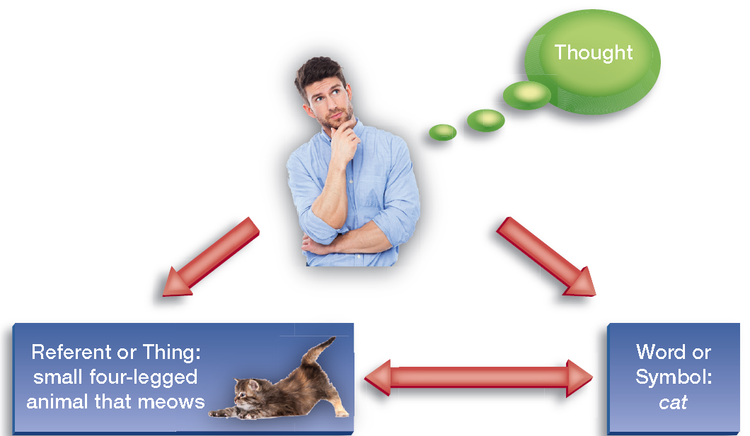
How Words Work (2 of 5)
Figure 6.1 Triangle of Meaning
Notes:
A man touching his chin and looking up, with a bubble coming from him that says “Thought.” Two arrows point away from him, one to a box that has a kitten playing with a toy and it says “Referent or Thing: small four-legged animal that meows” and the other arrow says “Word or Symbol: cat.” These two boxes also have a two-way arrow between them.

Slide 5
How Words Work (3 of 5)
Words are Symbols (continued)
Words are denotative and connotative.
Figure 6.2 A Word Can Sometimes Mean Different Things for Different People Depending on Their Experiences
Notes:
Denotative meaning: restrictive of literal definition of a word.
Connotative meaning: personal and subjective association with a word.

Slide 6
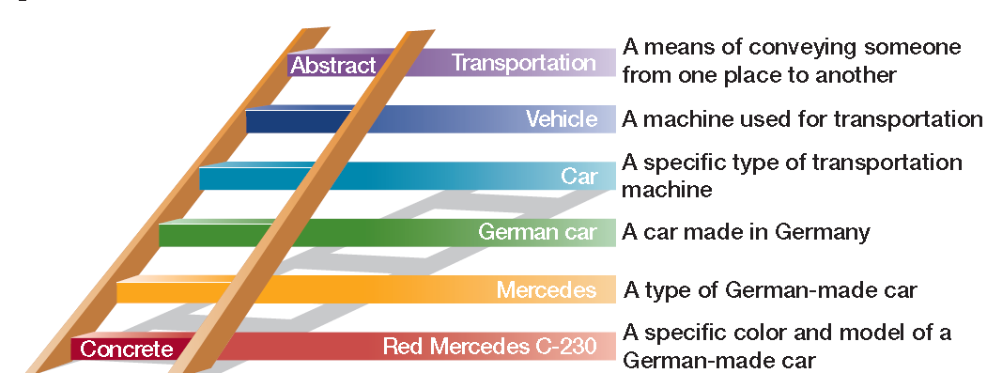
How Words Work (4 of 5)
Words are Symbols (continued)
Words are concrete and abstract.
Figure 6.3 A Ladder of Abstraction

Slide 7
How Words Work (5 of 5)
Many Words Are Arbitrary
Most words have accepted general meaning, but there is not typically a logical connection between a word and what it represents.
Onomatopoeia
Words Are Culture-Bound
Meaning can change from culture to culture.
Symbolic interaction theory (meanings determined by context)
Notes:
Onomatopoeia: a word that imitates a sound associated with what is named; also, the use of such word

Slide 8
The Power of Words (1 of 5) 6.2 Identify how words influence our perceptions, thoughts, actions, culture, and relationships.
Words Create Perceptions
Words help name and label what you experience and help you to create how you perceive the world.
You create your self-worth largely with self-talk and the labels you apply to yourself.
Words Influence Thoughts
Words and thought are inextricably linked; the process of hearing, seeing, or saying influences different parts of the brain.

Slide 9
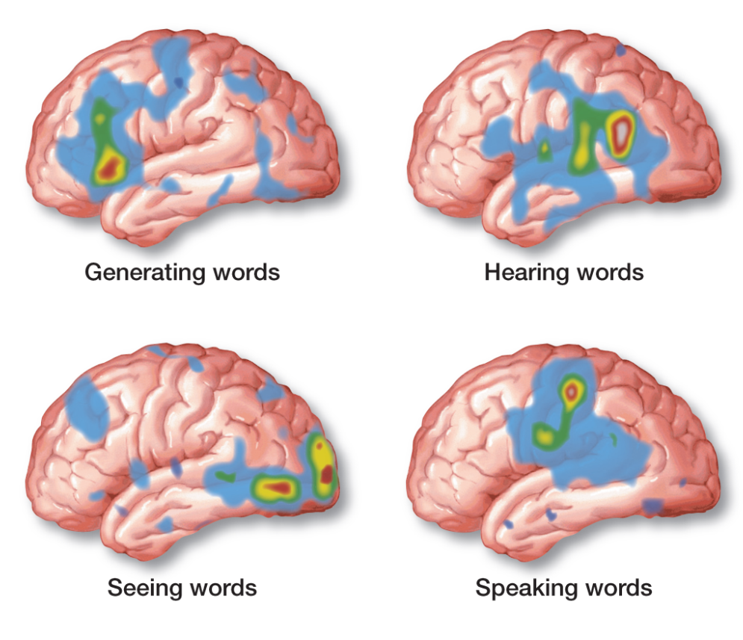
Figure 6.4 Words Influence Brain Activity

Slide 10
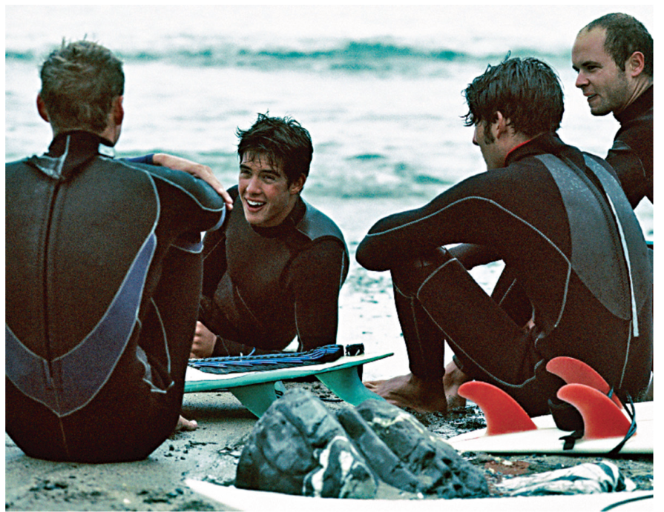
The Power of Words (3 of 5)
Words Influence Actions
Thoughts affect behavior.
Words Affect and Reflect Culture
Linguistic determination
Linguistic relativity
Sapir-Whorf hypothesis
Worldview
Surfers have created their own special
language as part of the culture they share.
Notes:
Linguistic determination: the theory that describes how use of language determines or influences thoughts and perceptions
Linguistic relativity: the theory that states each language includes some unique features that are not found in other languages
Sapir-Whorf hypothesis: based on the principles of linguistic determination and linguistic relativity, the hypothesis that language shapes our thoughts and culture, and our culture and thoughts affect the language we use to describe our world
Worldview: individual perceptions or perceptions by a culture or group of people about key beliefs and issue such as death, God, and the meaning of life, which influence interaction with others

Slide 11
The Power of Words (4 of 5)
Words Make and Break Relationships
What you say and how you say it, verbally or nonverbally have a strong impact on how you relate to others.
Clues to Our Relationships Are Found in Our Word Choice
Research has found that certain words, or backchannel talk, indicate a more intimate relationship.
Words influence relationships when we express our emotions and feelings during our conversations.

Slide 12
The Power of Words (5 of 5)
Clues to Our Relationships Are Found in What We Don’t Say
Profanity has an impact on our relationship with others.
Euphemisms can also soften the impact of an event, but are less direct.
Clues to Our Relationships Are Found in Our Tweets, Texts, and Posts
The words we use or others use about us online provide information about us in ways we may not be consciously aware.
Notes:
Profanity: words considered obscene, blasphemous, irreverent, rude, or insensitive
Euphemism: a mild or indirect word that is substituted for one that describes something vulgar, profane, unpleasant, or embarrassing

Slide 13
How to Manage Misunderstandings (1 of 4) 6.3 Identify and describe word barriers that lead to misunderstandings.
Be Aware of Missed Meaning
Bypassing causes language to be misunderstood. (see below)
Be Clear
Malapropisms
Using words out of context, using inappropriate grammar, or putting words in the wrong order affects meaning.
Notes:
Bypassing: confusion caused by the fact that the same word can mean different things to different people
Malapropism: confusion of one word or phrase for another that sounds similar to it

Slide 14
How to Manage Misunderstandings (2 of 4)
Be Specific
Language should be specific and concrete; vague language can cause confusion and frustration.
Restricted code (see below)
Jargon
Allness
Indexing
Notes:
Restricted code: set of words that have particular meaning to a person, group, or culture
Jargon: another name for restricted code; specialized terms or abbreviations whose meanings are known only to members of a specific group
Allness: tendency to use language to make unqualified, often untrue generalizations
Indexing: avoiding generalizations by using statements that separate one situation, person, or example from another

Slide 15
How to Manage Misunderstandings (3 of 4)
Be Aware of Changes in Meaning
Word meanings change over time.
Avoid static evaluation.
Be Aware of Polarizing Either-or Extremes
Avoid polarization; the world is not black and white.
Notes:
Static evaluation: a pronouncement that does not take the possibility of change in to consideration
Polarization: description and evaluation of what you observe in terms of extremes such as good or bad, old or new, beautiful or ugly

Slide 16
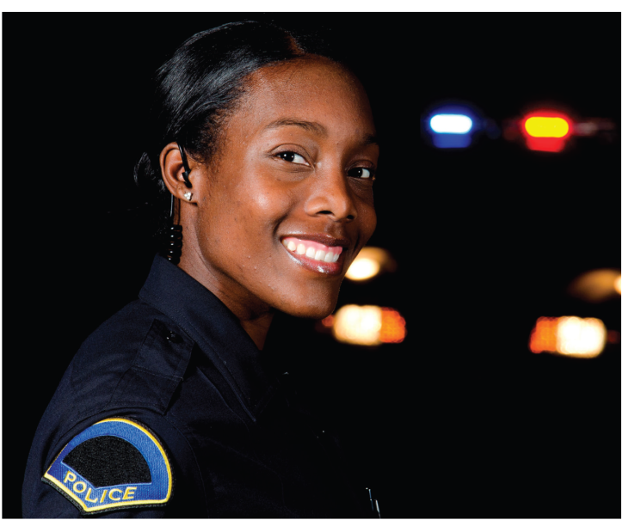
How to Manage Misunderstandings (4 of 4)
Be Unbiased
Hate speech
Avoid sexist language.
Avoid ethnically or racially biased language.
Avoid demeaning language.
The term policeman fails to accurately
describe the person shown here. A
more inclusive term would be police officer.
Notes:
Hate speech: words or phrases intended to offend or show respect for someone’s race, ethnicity, cultural background, gender, or some other aspect of that person’s identity

Slide 17
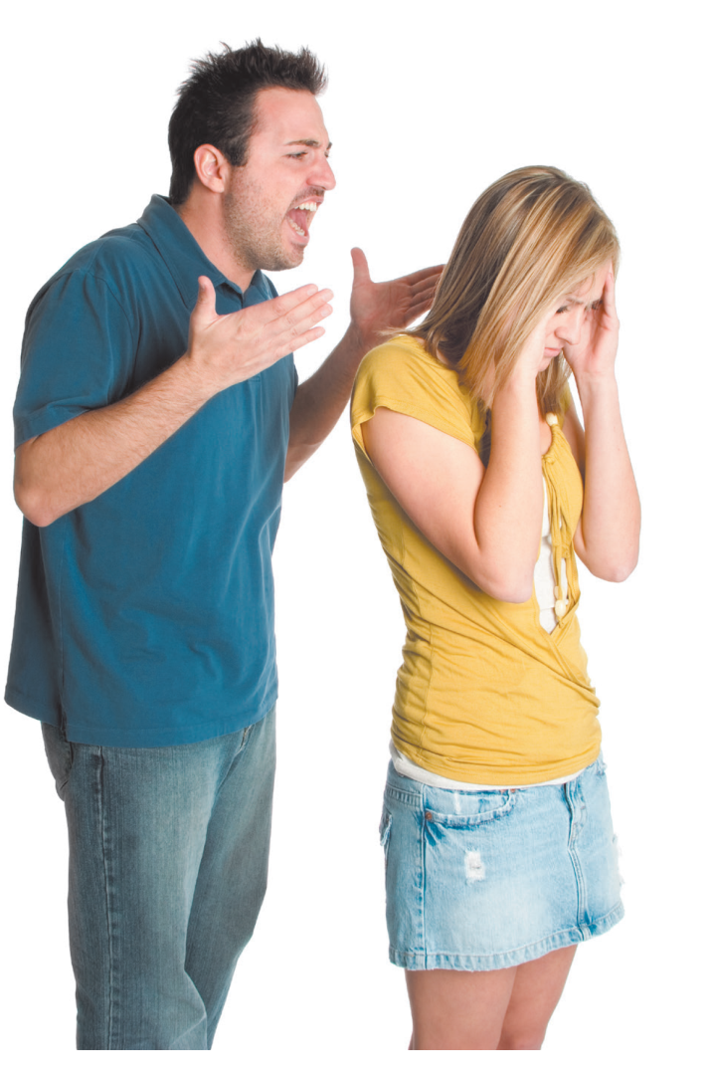
How to Use Words of Support and Comfort (1 of 4) 6.4 Use words to provide support and comfort, and to avoid defensiveness.
Describe Your Feelings, Rather Than Evaluate Behavior
Evaluation creates a climate of defensiveness.
Use extended “I” language
A climate of defensiveness left unchecked can escalate into interpersonal conflict. Using description “I” language rather than evaluative “you” language can help you manage tension and disagreement.
Notes:
Extended “I” language: brief preface to a feedback statement, intended to communicate that you don’t want your listener to take your message in an overly critical way

Slide 18
How to Use Words of Support and Comfort (2 of 4)
Solve Problems Rather Than Control
Work through problems and issues together.
Avoid asserting control by asking opening ended questions.
Be Genuine Rather Than Manipulative
Honestly seek to be yourself without a hidden agenda.

Slide 19
How to Use Words of Support and Comfort (3 of 4)
Empathize Rather Than Remain Detached
Be other-oriented; understand the feelings of others, and predict their emotional responses.
Being Flexible Rather Than Rigid
Use language that allows others to express their points of view.

Slide 20
How to Use Words of Support and Comfort (4 of 4)
Present Yourself as Equal Rather Than Superior
Create a supportive climate by using communication that is concrete and conveys mutual respect.
Avoid using abstract language or professional jargon to impress others.
When communicating with someone from another culture, you may need to use an elaborated code.
Notes:
Elaborated code: conversation that uses many words and various ways of describing an idea of concept to communicate its meaning

Slide 21
How to Have a Conversation (1 of 1) 6.5 Use words to have a conversation with others.
Starting a Conversation
Let the situation, time, location, and other person naturally guide how to start a conversation.
Impact of technology
Sustaining a Conversation
Ask open-ended questions.
Listen.
Don’t ask predetermined questions.
Notes:
Conversation: the spontaneous, interactive exchange of messages with another person

Slide 22
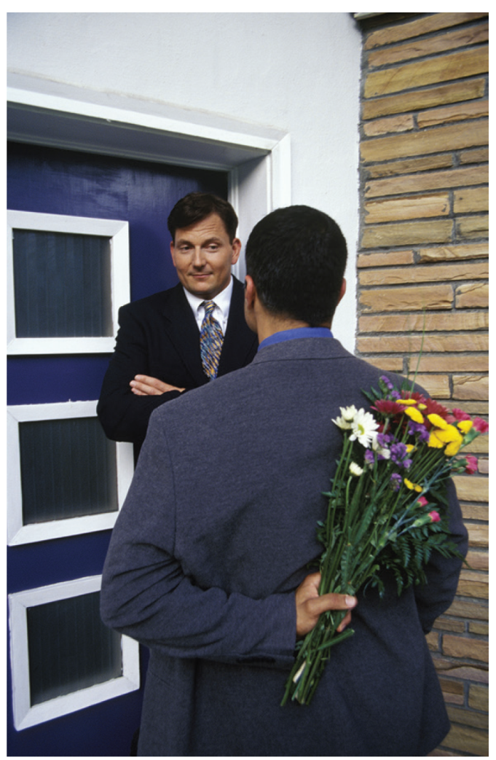
How to Apologize (1 of 1) 6.6 Use words to offer an apology when appropriate.
How to Apologize
When you make a mistake, offer an apology.
This can repair relational stress.
An apology can help you save face when you have made a relationship blunder and can relieve tension between you and another person.
Notes:
Apology: Explicit admission of an error, along with a request for forgiveness

Slide 23
How to Be Assertive (1 of 3) 6.7 Use assertiveness skills appropriately and ethically.
How to Be Assertive
Be assertive, not aggressive.
Learn to assert yourself by practicing five key behaviors.
Describe
Disclose
Identify effects
Be silent
Paraphrase
Notes:
Assertive: able to pursue one’s own best interests without denying a partner’s rights
Aggressive: Expressing one’s interests while denying the rights of others by blaming, judging, and evaluating other people

Slide 24
How to Be Assertive (2 of 3)
Describe
Describe how you view the situation.
Monitor your nonverbal message.
Disclose
Tell the other person how you feel.
Use word pictures.
Notes:
Word picture: Short statement or story that illustrates or describes an emotion; word pictures often use a simile (a comparison using the word like or as) to clarify the image.

Slide 25
How to Be Assertive (3 of 3)
Identify Effects
Identify effects of the other person’s behavior on you or others.
Be Silent
Wait for a response, and monitor nonverbal cues.
Paraphrase
Restate both the content and feelings of the message.

